Slide 1
CREDIT CARD DASHBOARD

Slide 2
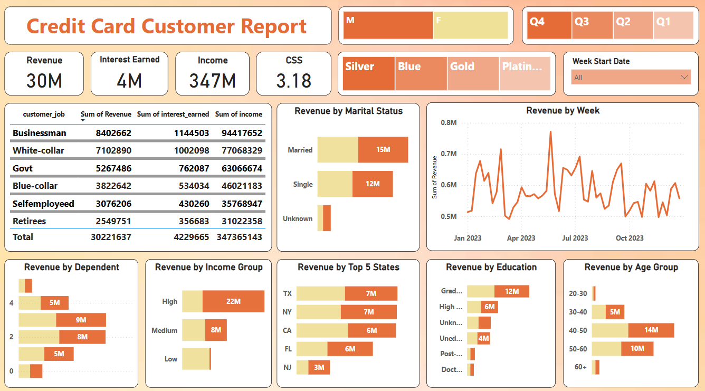
Credit Card Customer Report Dashboard

Slide 3
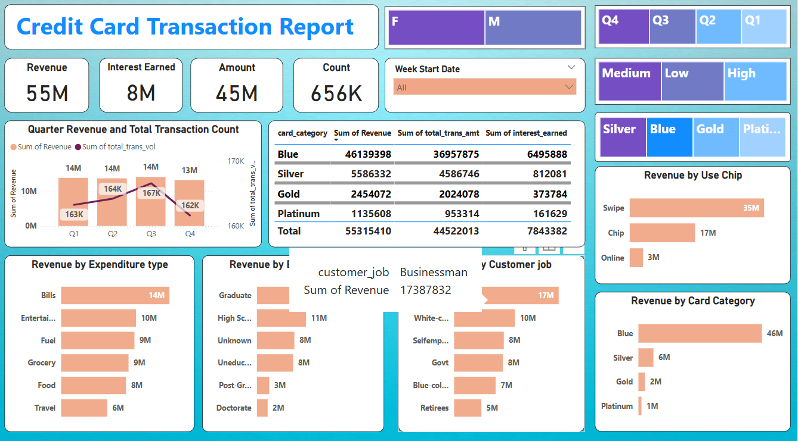
Credit Card Transaction Report Dashboard

Slide 4
OVERVIEW OF THE DASHBOARD
Overall revenue is 55 Million.
Total interest earned is 8 Million.
Total transaction amount is 45 Million.
Quarterly revenue and transaction count was highest in the third quarter.
Male customers are contributing more i.e. Male 25M and Female 20M.
Blue Card holders have the highest revenue of 45M.
Blue and Silver card customers are contributing the majority part of 90%.
40-50 age group customers are generating more revenues.

Slide 5
Credit Card Financial Dashboard with Power BI
Developed an interactive dashboard using customer data and transaction from SQL Database.
Cleaned the data for better reports and streamlined data processing to monitor and analyse key performance.
Shared actionable insights with the stakeholders based on the dashboard.
Figured out the findings to support decision making process.

